Slide 1
How to grab and object in VR Unreal Engine 5

Slide 2
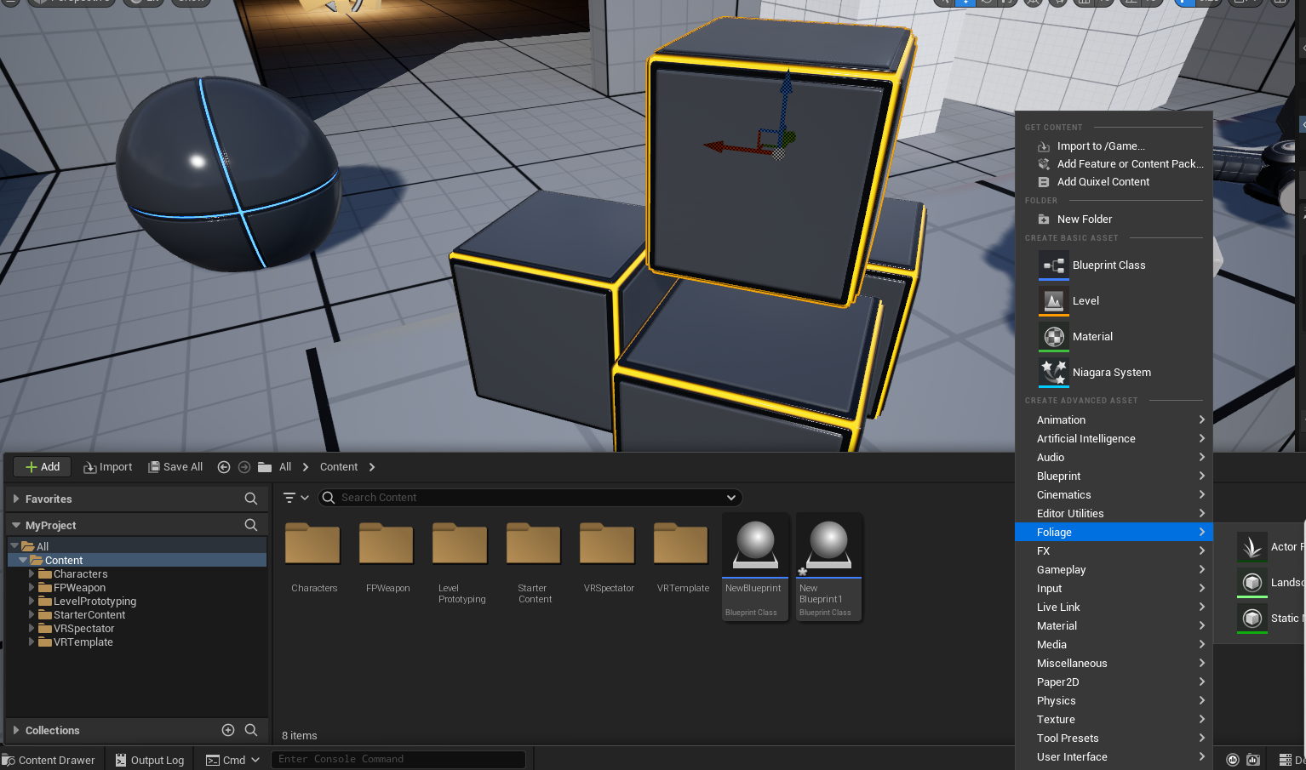
Step 1: Click on content folder
Right click on an empty area
A menu should pop up to the right.

Slide 3
Step 2: Import Shape
If you would like to use the shapes that is already provided in Unreal Engine 5, you can simply drag and drop it into the menu section and same goes for if you import a 3D Model.
Tip: If you want to import a certain shape you must download the 3D model. Some websites to use for 3D objects would be:
https://sketchfab.com/
https://www.cgtrader.com/

Slide 4
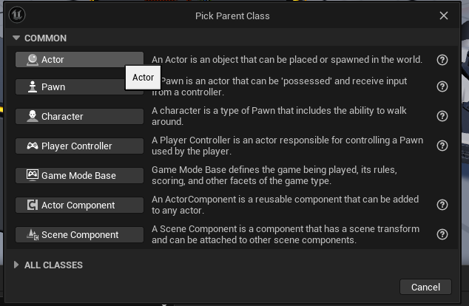
Step 3: Right click and open up new BluePrint
A text box will pop-up and make sure to click Actor. Then feel free to name the blueprint object anything you’d like.

Slide 5
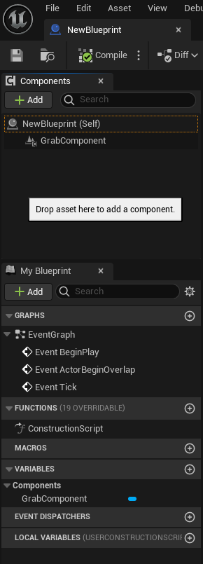
Step 4: Attaching GrabComponent to object
Double click on your new blueprint. On the left hand side there is a section calle components. Here you can search for the grab component and attach it to.
If you have imported an object where it says NewBlueprint (Self) to the right should be where your object is.

Slide 6
Step 5: That's it!
Don’t forget to click save!

